Slide 1

CSBridge
Notes:
And I will be one of the two lecturers for this course.

Slide 2
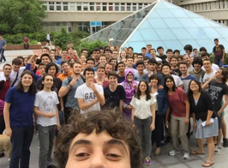
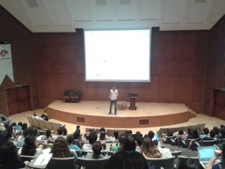
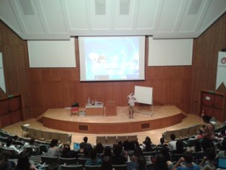
Darüşşafaka Lisesi. 2014
Boğaziçi Ünv. 2015
Koç Ünv. 2016
Koç Ünv. 2017
CTU, Czech Republic +
Koç Ünv. 2018
Notes:
A program that teaches high school students like yourselves computer science
20 students → 100 → 200 → 300 in 2 countries!

Slide 3
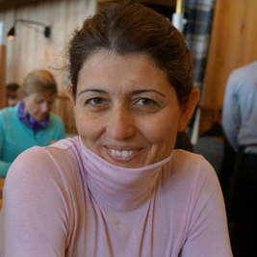

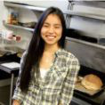
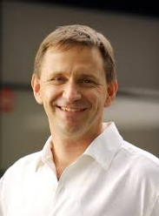
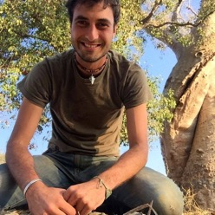
Asena
Bryce
Julia
Nick
Chris

Slide 4
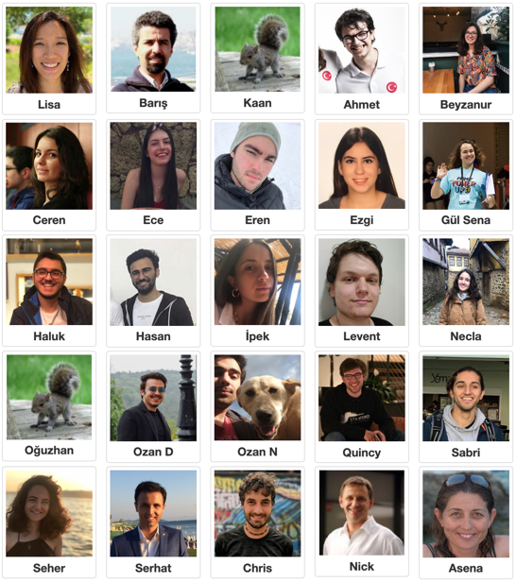
Our awesome 2019 Koç teaching team!
Notes:
My name is Lisa, and I will be leading the morning lectures in English. Baris who is in the second picture at the very top, is going to lead the afternoon lectures in Turkish.
You’ve met your section leaders already, who are all wonderful teachers ready to help you learn CS!
Some of your teachers first started in this program, and now they are doing Computer Science at university. How cool is that? So what you learn in these two weeks can really go a long way.

Slide 5


Pelin
Barış
Notes:
VPRD office CS Bridge program managers, who have been arranging your transportation and emails!

Slide 6
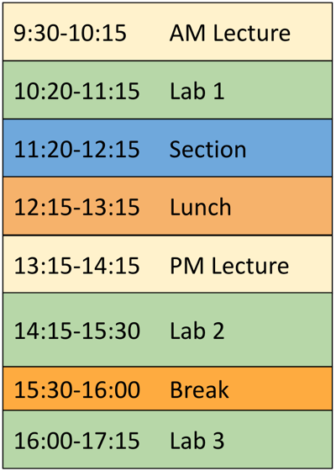
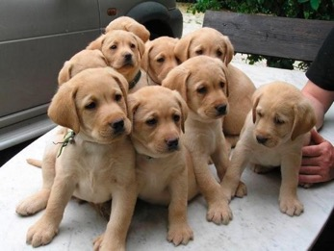



Logistics
LOL: Lots of Labs!
(computer)
Labrador Retrievers (Labs)
Notes:
The whole goal of this program is for you to Learn by doing!!
Schedule is fluid
Explain purpose of lab/section.

Slide 7
Logistics
Discussion Section
Meet your friends and talk through problems with your Section Leader!
Notes:
Schedule is fluid
Explain purpose of lab/section.
Learn by doing!!
Step away from the computer and think
With some of the Stanford and Koc university students.

Slide 8
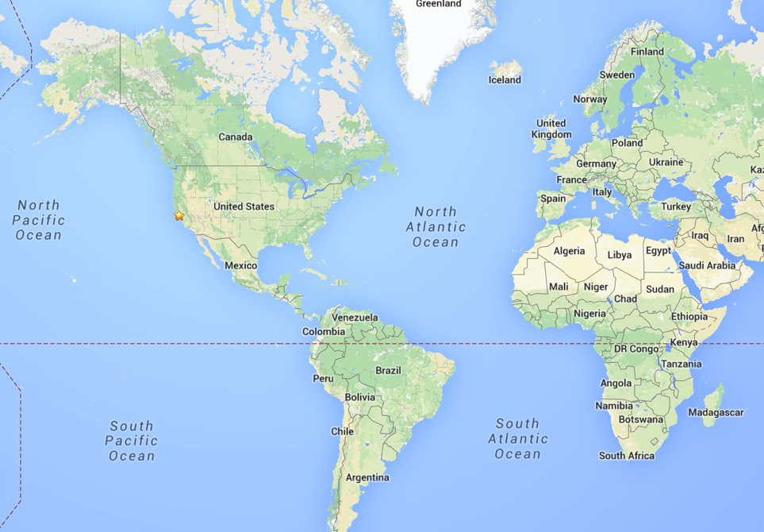


Stanford?
Notes:
Language
Call me Lisa
Play tennis, watch a lot of Japanese anime, and I love computer science. I also think Turkish food is the best food in the world.

Slide 9
Stanford
Notes:
I currently teach computer science at Stanford.
Did Masters and PhD in Electrical Engineering at Stanford.
I first started computer science in my first year of university.
How much experience did I have when I first did this material? Basically nothing.
It was difficult for me too.
And then I worked on computer science and electrical engineering all through school, until I joined CS Bridge three years ago, when it first came to Koç. And that experience really transformed me, because I saw how much of an impact computer science can have on all of you. And that’s why I’m teaching today.
We want all of you to be successful
That’s why we have such a large course staff
But over years and years and years we have been working on our material so that everyone gets through…
Not competing against anyone but yourself. Everyone can win!

Slide 10

Prerequisites
Notes:
What do you need to know for this class?
Just need to know how to turn on a computer and ask for help.
We love questions!!!

Slide 11
Course Website
http://koc.csbridge.org
*note that its org, not com
Notes:
Link to sign into lab

Slide 12
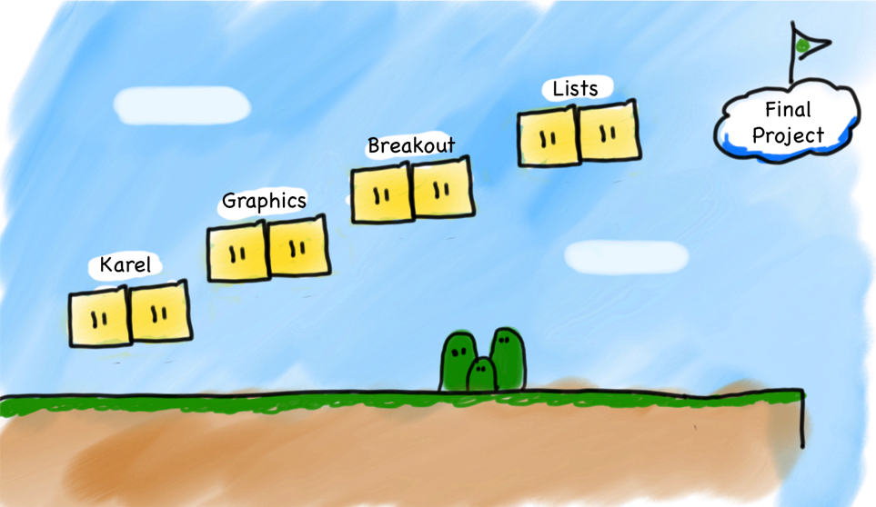
Very High Level Journey
Notes:
hanging out with a cool robot
draw graphics on the screen
program this game called Breakout
work with an important data abstraction called lists
have you create your very own special final project.
We happen to work in Java for this course
we will teach some specific things (Java syntax, Karel commands) but more importantly…
We teach software engineering principles and logic. Much larger than just programming.
Mechanics of the language are nothing compared to the principles.
You are going to learn the principles by programming in Java
(It's not about learning Java)
lots of words on this slide...what do they mean?

Slide 13
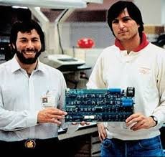
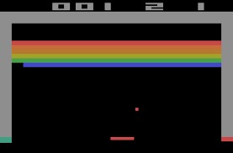
Notes:
Breakout demo!
Atari arcade game 1976 = 43 years ago

Slide 14
Breakout
Notes:
You are going to program this.
But Lisa, I don't even know what it looks like!
start programming it by Friday

Slide 15
What if I fall behind?
CS Bridge
Notes:
remember that you're not learning alone.
Ask for help. (friends or us) always around to help you
We promise that we will help every one of you will be able to program Breakout by the end of this course.

Slide 16
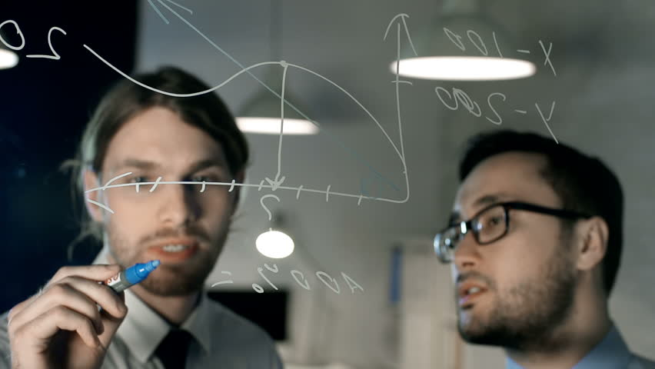
Share Ideas Not Code
Notes:
Goal not to just code Breakout, but to <learn> how to be a computer and software engineer.
There’s no grades
CS Bridge is your own experience, and that means that we want you to learn and get something out of it.

Slide 17
Our First Step
Notes:
hanging out with a cool robot
draw graphics on the screen
program this game called Breakout
work with an important data abstraction called lists
have you create your very own special final project.
We happen to work in Java for this course
we will teach some specific things (Java syntax, Karel commands) but more importantly…
We teach software engineering principles and logic. Much larger than just programming.
Mechanics of the language are nothing compared to the principles.
You are going to learn the principles by programming in Java
(It's not about learning Java)
lots of words on this slide...what do they mean?

Slide 18

Karel
Notes:
And now we’re going to jump right into it. We will take our very first step into CS.
Everyone say, “Merhaba Karel!”

Slide 19

Karel Speaks Java
s
Notes:
Karel is a gentle introduction to computer science
because her life is very simple.

Slide 20


Karel’s World
North
3
+
+
+
+
+
2
+
+
+
+
+
West
East
1
+
+
+
+
+
South
1
2
3
4
5

Slide 21

Walls
3
+
+
+
+
2
+
+
+
+
1
+
+
+
+
1
2
3
4

Slide 22

Beepers
3
+
+
+
+
2
+
+
+
+
1
+
+
+
+
1
2
3
4

Slide 23
Knows Four Commands
move();
turnLeft();
pickBeeper();
putBeeper();
Notes:
Semicolon at end

Slide 24
move();
Notes:
what do each of these commands do?

Slide 25

move();
3
+
+
+
+
2
+
+
+
+
1
+
+
+
+
1
2
3
4

Slide 26
move();
3
+
+
+
+
2
+
+
+
+
1
+
+
+
+
+
1
2
3
4

Slide 27
turnLeft();

Slide 28
turnLeft();
3
+
+
+
+
2
+
+
+
+
1
+
+
+
+
+
1
2
3
4

Slide 29
turnLeft();
3
+
+
+
+
2
+
+
+
+
1
+
+
+
+
+
1
2
3
4

Slide 30
pickBeeper();

Slide 31
pickBeeper();
3
+
+
+
+
2
+
+
+
+
1
+
+
+
+
+
1
2
3
4
Notes:
karel is on top of the beeper
puts it in her beeper bag

Slide 32
pickBeeper();
3
+
+
+
+
2
+
+
+
+
1
+
+
+
+
+
1
2
3
4

Slide 33
putBeeper();
3
+
+
+
+
2
+
+
+
+
1
+
+
+
+
+
1
2
3
4

Slide 34
putBeeper();
3
+
+
+
+
2
+
+
+
+
1
+
+
+
+
+
1
2
3
4
Notes:
Today, we're going to navigate Karel through her daily life in her world with just four commands. It’s gonna be great.

Slide 35
Questions?
Notes:
About the program logistics, Karel, about where this program is going?

Slide 36
First Challenge
3
+
+
+
+
2
+
+
+
+
1
+
+
+
+
1
2
3
4

Slide 37
First Challenge
3
+
+
+
+
2
+
+
+
+
1
+
+
+
+
1
2
3
4

Slide 38

Need a Volunteer
Notes:
I'm gonna be Karel, and this is my beeper.

Slide 39
First Challenge
move();
pickBeeper();
turnLeft();
putBeeper();

Slide 40

Let’s Try It
StepUp.java

Slide 41
Questions?

Slide 42
Improving our Program
import stanford.karel.*;
public class StepUp extends Karel {
public void run() {
move();
pickBeeper();
move();
turnLeft();
move();
turnLeft();
turnLeft();
turnLeft();
move();
putBeeper();
move();
}
}
It’s “Turn Right”, but…
🙁 not very clear
😩 tedious
Notes:
We are very happy with our program, but we know that we can always improve. So let’s look at what we can improve.
Not very clear
tedious

Slide 43
Improving our Program
import stanford.karel.*;
public class StepUp extends Karel {
public void run() {
move();
pickBeeper();
move();
turnLeft();
move();
// turns Karel right
turnLeft();
turnLeft();
turnLeft();
move();
putBeeper();
move();
}
}
It’s “Turn Right”, but…
✅ descriptive comments
😩 tedious

Slide 44
Anatomy of a Program
import stanford.karel.*;
public class StepUp extends Karel {
public void run() {
move();
pickBeeper();
move();
turnLeft();
move();
// turns Karel right
turnLeft();
turnLeft();
turnLeft();
move();
putBeeper();
move();
}
}
This is the program's source code
Notes:
Let me give you some definitions of parts of our program, to show you how we can improve it.

Slide 45
Anatomy of a Program
import stanford.karel.*;
public class StepUp extends Karel {
public void run() {
move();
pickBeeper();
move();
turnLeft();
move();
// turns Karel right
turnLeft();
turnLeft();
turnLeft();
move();
putBeeper();
move();
}
}
This piece of the program’s source code is called a method.

Slide 46
Anatomy of a Program
import stanford.karel.*;
public class StepUp extends Karel {
public void run() {
move();
pickBeeper();
move();
turnLeft();
move();
// turns Karel right
turnLeft();
turnLeft();
turnLeft();
move();
putBeeper();
move();
}
}
This word is the name of our method (here, run)
We must always have a run() method to run our program.
But we can make any other methods we want!

Slide 47
Method Definition
private void name() {
statements in the method body
}
This adds a new command to Karel’s vocabulary

Slide 48
Improving our Program
import stanford.karel.*;
public class StepUp extends Karel {
public void run() {
move();
pickBeeper();
move();
turnLeft();
move();
turnRight();
move();
putBeeper();
move();
}
private void turnRight() {
turnLeft();
turnLeft();
turnLeft();
}
}
Call our turnRight method
Define a turnRight method

Slide 49
Anatomy of a Program
import stanford.karel.*;
public class StepUp extends Karel {
public void run() {
move();
pickBeeper();
move();
turnLeft();
move();
turnRight();
move();
putBeeper();
move();
}
private void turnRight() {
turnLeft();
turnLeft();
turnLeft();
}
}
This is called an import statement. It tells Java what Karel is.
Notes:
All these semicolons

Slide 50
Anatomy of a Program
import stanford.karel.*;
public class StepUp extends Karel {
public void run() {
move();
pickBeeper();
move();
turnLeft();
move();
turnRight();
move();
putBeeper();
move();
}
private void turnRight() {
turnLeft();
turnLeft();
turnLeft();
}
}
This is called a code block.
Notes:
Which separates logical parts of your code.

Slide 51
Program Style
import stanford.karel.*;
public class StepUp extends Karel {
public void run() {
move();
pickBeeper();
move();
turnLeft();
move();
turnRight();
move();
putBeeper();
move();
}
private void turnRight() {
turnLeft();
turnLeft();
turnLeft();
}
}
These are terrifying!
Notes:
That's technically correct, but a little difficult to look at.
because I'm not sure where code blocks, those logical segments of my program, start and end.
And so what I’m going to talk about next won’t help your program run better, but it will help you think better. And it’s always good to organize your thoughts on paper, so this is organizing your code on the computer.
And this is called good *style* when programming.

Slide 52
Program Style
import stanford.karel.*;
public class StepUp extends Karel {
public void run() {
move();
pickBeeper();
move();
turnLeft();
move();
turnRight();
move();
putBeeper();
move();
}
private void turnRight() {
turnLeft();
turnLeft();
turnLeft();
}
}
Style Tip #1:
Align braces in your code blocks.
Notes:
Talk about indentation

Slide 53
Program Style
import stanford.karel.*;
public class StepUp extends Karel {
public void run() {
move();
pickBeeper();
move();
turnLeft();
move();
turnRight();
move();
putBeeper();
move();
}
private void turnRight() {
turnLeft();
turnLeft();
turnLeft();
}
}
Style Tip #1:
Align braces in your code blocks.
Notes:
Talk about indentation

Slide 54
Program Style
import stanford.karel.*;
public class StepUp extends Karel {
public void run() {
move();
pickBeeper();
move();
turnLeft();
move();
turnRight();
move();
putBeeper();
move();
}
private void turnRight() {
turnLeft();
turnLeft();
turnLeft();
}
}
Style Tip #1:
Align braces in your code blocks.
Notes:
Talk about indentation

Slide 55
Program Style
import stanford.karel.*;
public class StepUp extends Karel {
public void run() {
move();
pickBeeper();
move();
turnLeft();
move();
turnRight();
move();
putBeeper();
move();
}
private void turnRight() {
turnLeft();
turnLeft();
turnLeft();
}
}
Style Tip #2:
Align indentation in your code blocks.
Notes:
Talk about indentation

Slide 56
Program Style
import stanford.karel.*;
public class StepUp extends Karel {
public void run() {
move();
pickBeeper();
move();
turnLeft();
move();
turnRight();
move();
putBeeper();
move();
}
private void turnRight() {
turnLeft();
turnLeft();
turnLeft();
}
}
Style Tip #2:
Align indentation in your code blocks.
Notes:
Talk about indentation

Slide 57
Questions?
Notes:
About the program logistics, Karel, about where this program is going?

Slide 58
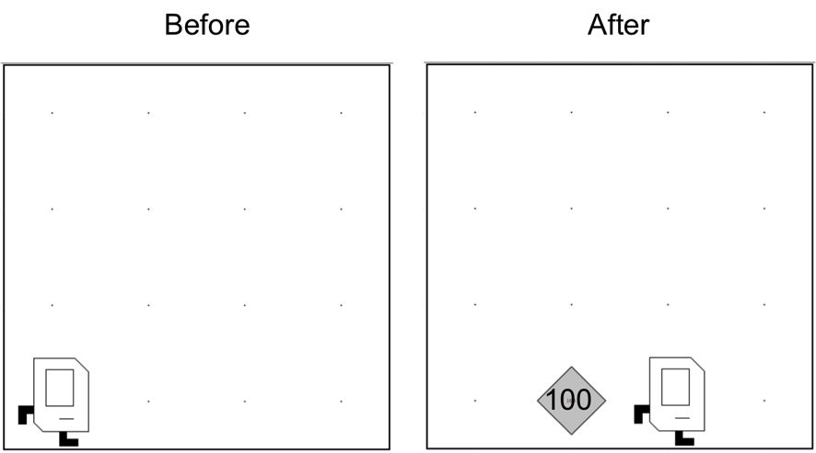
Place 100 beeper?
Place100.java
Notes:
Do I have the solution for you. Beautiful style
And this program works, but there must be a better way!

Slide 59
For Loop
for(int i = 0; i < N; i++) {
// to repeat N times
}
Notes:
anything inside this code block, that means inside these braces,
I will repeat N times. where N is a number I specify.

Slide 60
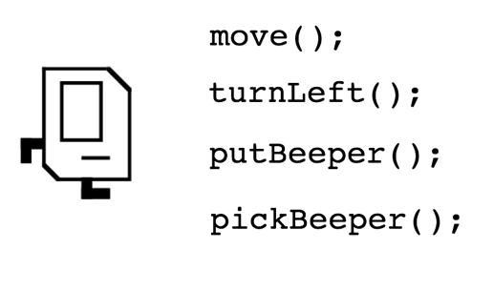
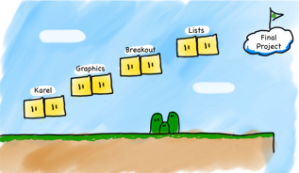
Review
Helper methods for defining new commands
private void name() {
statements in the method body
}
for loops repeat code N times
N
for(int i = 0; i < N; i++) {
// to repeat N times
}
Notes:
Defining new commands to keep our code clean, that was us defining turnRight() and being able to use that instead of three turnLefts
Repeat something exactly N times.

Slide 61
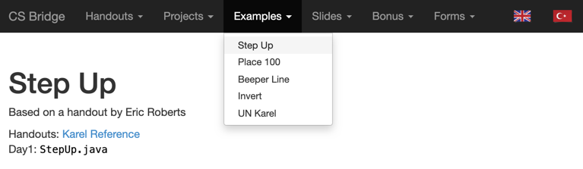
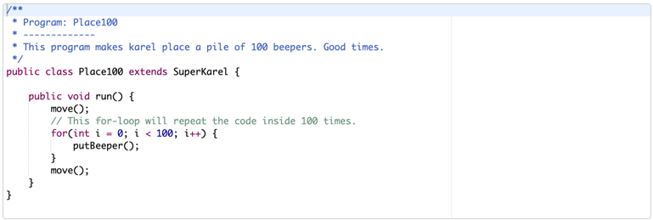
Today’s Examples on the Website

Slide 62
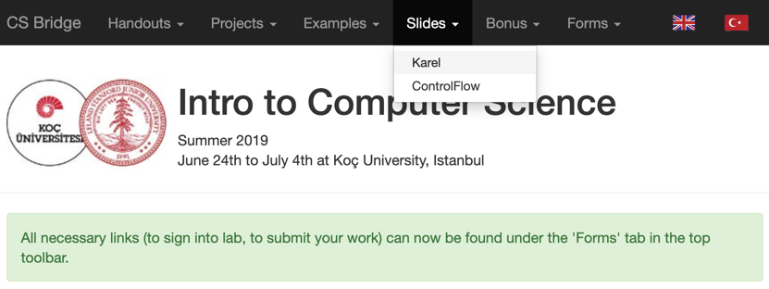
Today’s Slides on the Website

Slide 63
Your turn
x 200
(in Labs)
Notes:
It's your turn to become wizards!

Slide 64
Newspaper Karel

Slide 65
Build Efes
Notes:
Build the ancient city of Efes, by building columns of beepers.
(Temple of Artemis), Izmir

Slide 66

Your turn
To the Labs!!

Slide 67
What if I fall behind?
Different learning curves
My friend who had programmed before
Knowledge
Lisa (me)
Time
Notes:
First, it is okay! Everyone learns at a different pace.
Ask for help.

